Slide 1

TATA Internship - Data Visualization -Empowering Business with Effective Insights
Task 4 : Communicating insights and Analysis
Present by: HARSH KUMAR TOPPO

Slide 2
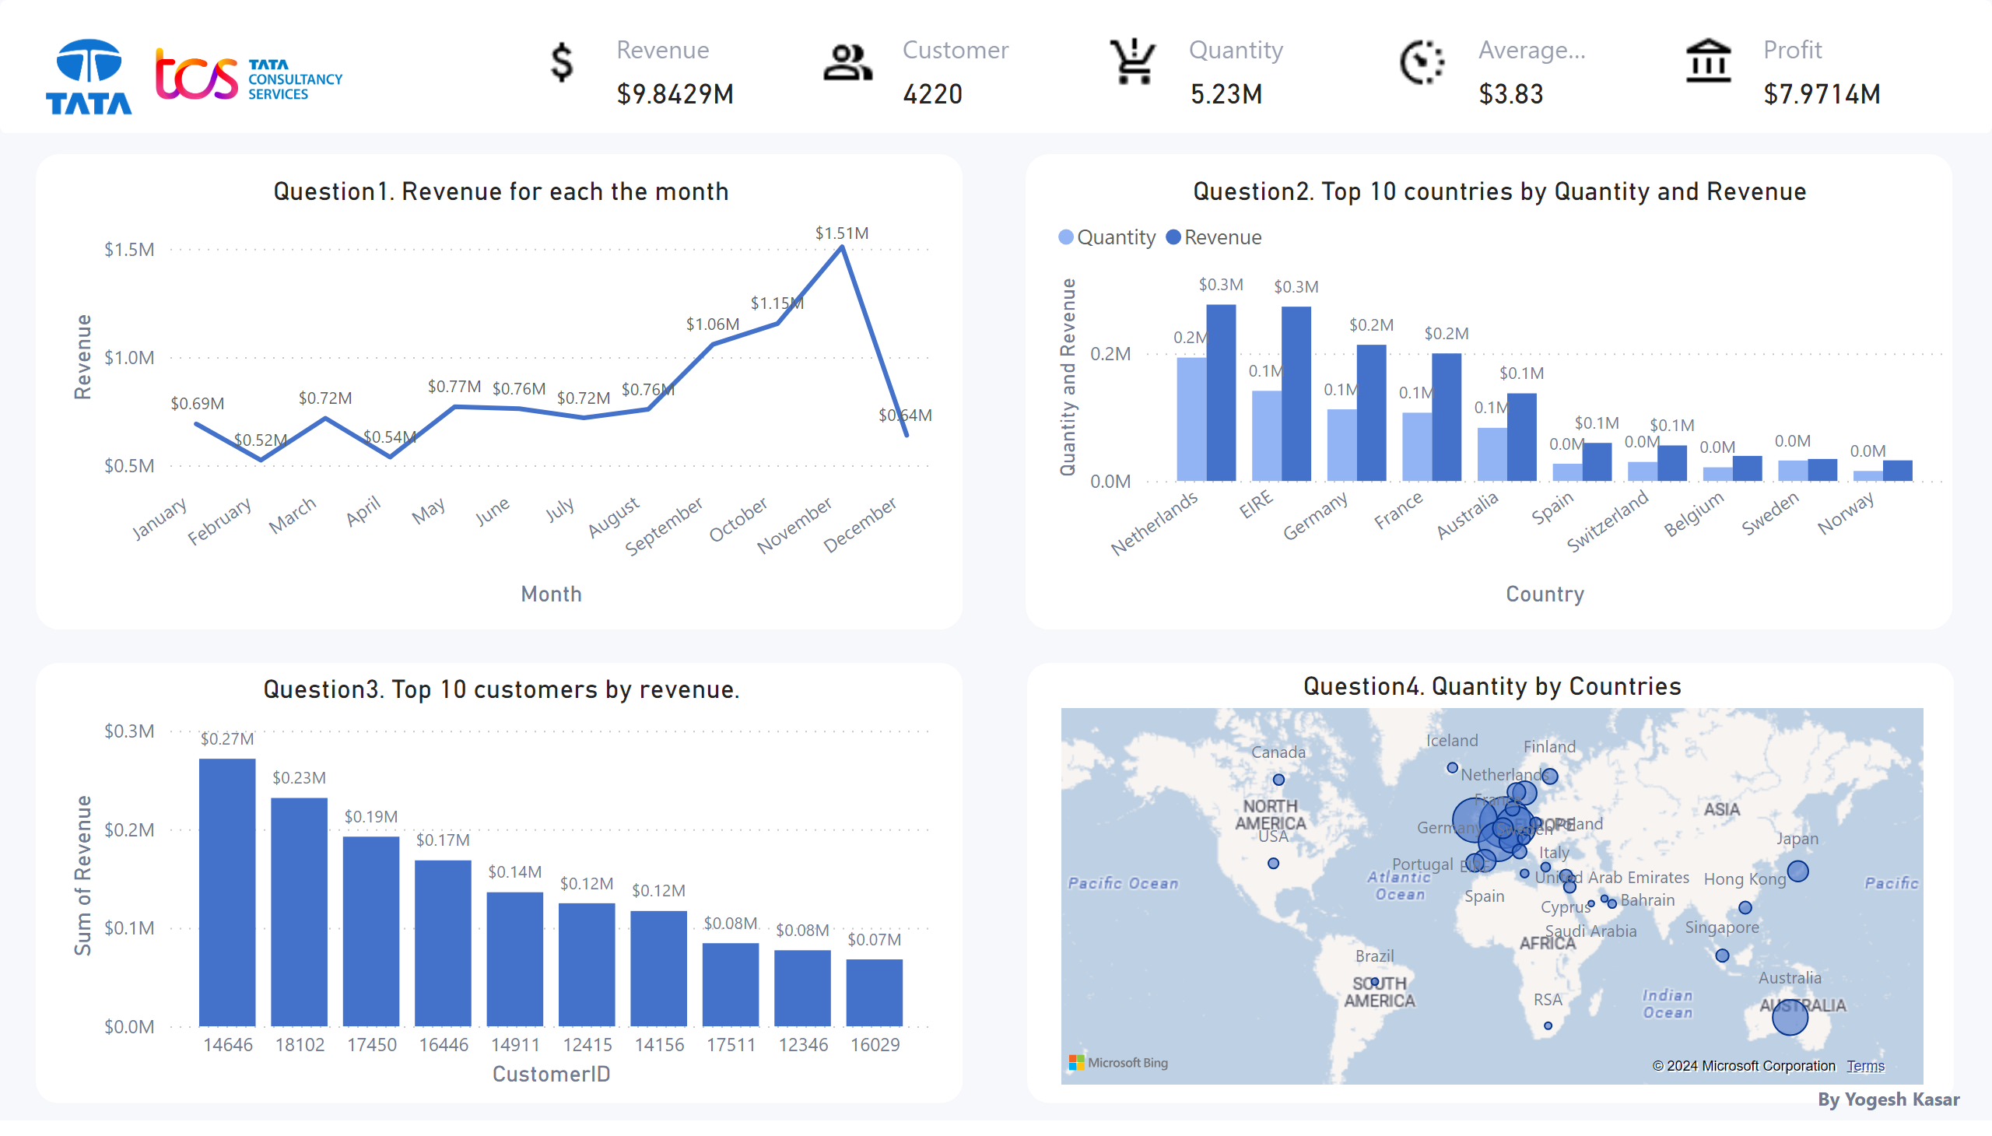
Page 1
Notes:
textbox
No alt text provided
image
No alt text provided
image
No alt text provided
image
No alt text provided
image
No alt text provided
image
No alt text provided
image
No alt text provided
image
No alt text provided
cardVisual
No alt text provided
cardVisual
No alt text provided
cardVisual
No alt text provided
cardVisual
No alt text provided
cardVisual
No alt text provided
shape
No alt text provided
Question4. Quantity by Countries
No alt text provided
Question3. Top 10 customers by revenue.
No alt text provided
Question2. Top 10 countries by Quantity and Revenue
No alt text provided
Question1. Revenue for each the month
No alt text provided
shape
No alt text provided
shape
No alt text provided
shape
No alt text provided
shape
No alt text provided

Slide 3
INTRODUCTION
An online retail store has hired you as a consultant to review their data and provide insights that would be valuable to the CEO and CMO of the business. The business has been performing well and the management wants to analyse what the major contributing factors are to the revenue so they can strategically plan for next year.
The leadership is interested in viewing the metrics from both an operations and marketing perspective. Management also intends to expand the business and is interested in seeking guidance into areas that are performing well so they can keep a clear focus on what’s working. They would also like to view different metrics based on the demographic information that is available in the data.
A meeting with the CEO and CMO has been scheduled for next month and you need to draft the relevant analytics and insights that would help evaluate the current business performance and suggest metrics that would enable them to make the decision on expansion.
Remember, thinking from the perspective of business leaders allows you to analyse the data more effectively and present better insights.
Access the links in the resources below to better understand how business leaders think and approach business performance.

Slide 4
Data Cleaning :
In this task I have cleaned data with number of process.
Firstly, I cleaned any records from quantities column and in that the quantity should not be below 1 unit. So, I have filter and remove the records in power query.
I have cleaned any records from unit prices column and in that the Unit price should not be below $0. So, I have filter and remove the records in power query.
After I loaded the data into power bi, since, these records needed to be removed in order to provide helpful analysis.
I have analyzed the entire data, the online retail business has gained 9.8429M revenue in the year 2011.
Ans the quantities is 5.2291M, customers is 4220, products is 3914, and overall profit is $7.9714M in the year of 2011

Slide 5
Page 1
Question 1 . The CEO of the retail store is interested to view the time series of the revenue data for the year 2011 only. He would like to view granular data by looking into revenue for each month. The CEO is interested in viewing the seasonal trends and wants to dig deeper into why these trends occur. This analysis will be helpful for the CEO to forecast for the next year.
A revenue trend analysis is to determine whether store sales are seasonal. According to my analysis, there are a few month in the year when remarkable increase is observed. The data shows that, the revenue in the first 8 months is fairly constant , as the average revenue generated for these 8 months is around $622k. The increase in revenue starts in the month of September . This trend continues till the month of November where it reached 1.51 million USD, the highest during the entire year. The data is incomplete for the month of December, therefore, no conclusion can be drawn from it, unfortunately. This analysis shows that the retail store sales are impacted by the seasonality which usually occurs in the last 4 months of the year.
Notes:
textbox
No alt text provided
image
No alt text provided
image
No alt text provided
image
No alt text provided
image
No alt text provided
image
No alt text provided
image
No alt text provided
image
No alt text provided
cardVisual
No alt text provided
cardVisual
No alt text provided
cardVisual
No alt text provided
cardVisual
No alt text provided
cardVisual
No alt text provided
shape
No alt text provided
Question4. Quantity by Countries
No alt text provided
Question3. Top 10 customers by revenue.
No alt text provided
Question2. Top 10 countries by Quantity and Revenue
No alt text provided
Question1. Revenue for each the month
No alt text provided
shape
No alt text provided
shape
No alt text provided
shape
No alt text provided
shape
No alt text provided

Slide 6
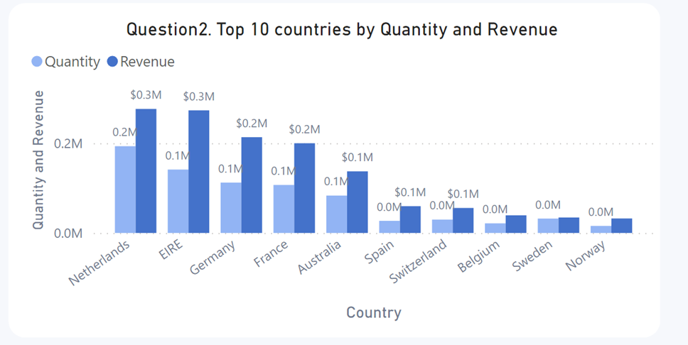
Page 1
Question 2 . The CMO is interested in viewing the top 10 countries which are generating the highest revenue. Additionally, the CMO is also interested in viewing the quantity sold along with the revenue generated. The CMO does not want to have the United Kingdom in this visual.
In this visual shows how the top 10 countries which have opportunities for growth are performing . The analysis shows that, such as the Netherlands, Ireland, Germany and France have volumes of units bought and revenue generated. I would be suggest that, these countries should be focused on to ensure that measures are taken to capture these markets even more.
Notes:
textbox
No alt text provided
image
No alt text provided
image
No alt text provided
image
No alt text provided
image
No alt text provided
image
No alt text provided
image
No alt text provided
image
No alt text provided
cardVisual
No alt text provided
cardVisual
No alt text provided
cardVisual
No alt text provided
cardVisual
No alt text provided
cardVisual
No alt text provided
shape
No alt text provided
Question4. Quantity by Countries
No alt text provided
Question3. Top 10 customers by revenue.
No alt text provided
Question2. Top 10 countries by Quantity and Revenue
No alt text provided
Question1. Revenue for each the month
No alt text provided
shape
No alt text provided
shape
No alt text provided
shape
No alt text provided
shape
No alt text provided

Slide 7
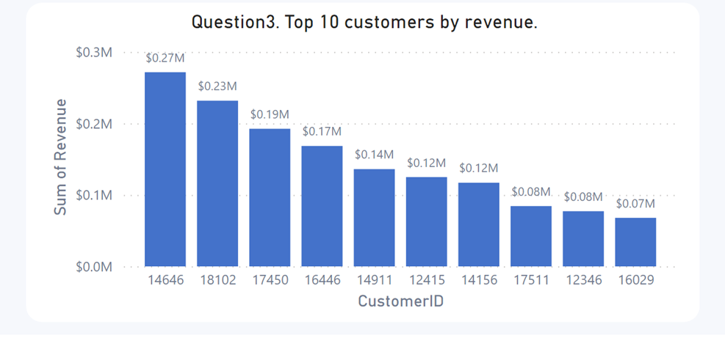
Page 1
Question 3 . The CMO of the online retail store wants to view the information on the top 10 customers by revenue. He is interested in a visual that shows the greatest revenue generating customer at the start and gradually declines to the lower revenue generating customers. The CMO wants to target the higher revenue generating customers and ensure that they remain satisfied with their products.
In this analysis has been performed on the top 10 customers who have purchased the most from the store. The data shows that, there is not much of a difference between the purchases made by the top 10 customers. The highest revenue generating customer only purchased 7% more than the second highest which shows the business is not relying only on a few customers to generate the revenue. This shows that, the bargaining power of customers is low and the business is in a good position.
Notes:
textbox
No alt text provided
image
No alt text provided
image
No alt text provided
image
No alt text provided
image
No alt text provided
image
No alt text provided
image
No alt text provided
image
No alt text provided
cardVisual
No alt text provided
cardVisual
No alt text provided
cardVisual
No alt text provided
cardVisual
No alt text provided
cardVisual
No alt text provided
shape
No alt text provided
Question4. Quantity by Countries
No alt text provided
Question3. Top 10 customers by revenue.
No alt text provided
Question2. Top 10 countries by Quantity and Revenue
No alt text provided
Question1. Revenue for each the month
No alt text provided
shape
No alt text provided
shape
No alt text provided
shape
No alt text provided
shape
No alt text provided

Slide 8
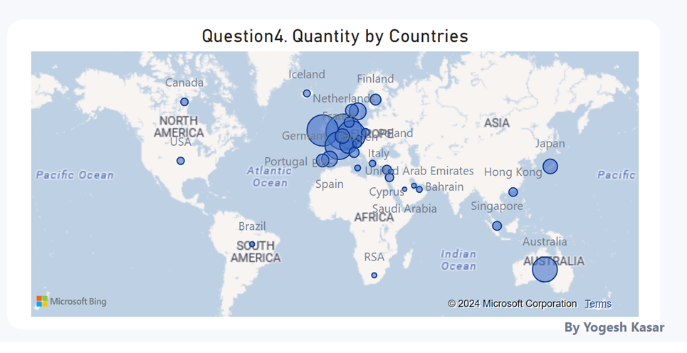
Page 1
Question 4 . The CEO is looking to gain insights on the demand for their products. He wants to look at all countries and see which regions have the greatest demand for their products. Once the CEO gets an idea of the regions that have high demand, he will initiate an expansion strategy which will allow the company to target these areas and generate more business from these regions. He wants to view the entire data on a single view without the need to scroll or hover over the data points to identify the demand. There is no need to show data for the United Kingdom as the CEO is more interested in viewing the countries that have expansion opportunities.
In this analysis the map chart shows, the regions that have generated the most revenue compared with the regions that have not. It can be seen that, countries such as Netherlands, Ireland, Germany, France and Australia are generating high revenue and the company should invest more in these areas to increase demand for products. The map also reveals that very few sales occur in the American region, with the majority of sales occurring mainly in the European zone, Africa and Asia do not have any demand for the products, along with Russia. A new strategy targeting these area has the potential to boost sales revenues and profitability.
Notes:
textbox
No alt text provided
image
No alt text provided
image
No alt text provided
image
No alt text provided
image
No alt text provided
image
No alt text provided
image
No alt text provided
image
No alt text provided
cardVisual
No alt text provided
cardVisual
No alt text provided
cardVisual
No alt text provided
cardVisual
No alt text provided
cardVisual
No alt text provided
shape
No alt text provided
Question4. Quantity by Countries
No alt text provided
Question3. Top 10 customers by revenue.
No alt text provided
Question2. Top 10 countries by Quantity and Revenue
No alt text provided
Question1. Revenue for each the month
No alt text provided
shape
No alt text provided
shape
No alt text provided
shape
No alt text provided
shape
No alt text provided

Slide 9
Thank You!
Yogesh Kasar

